Slide 1

ECE 603 Probability and Random Processes
Lessons 18-20
Chapter 10
Introduction to Random Processes
Notes:
Now: Slides with Annotation
Next: Slides with Annotation
*****Preparation Notes*****
Students taking this course should already have covered linear algebra elsewhere.
We will use linear algebra extensively in this course.

Slide 2
Objectives
Examine the concept of random processes.
Apply methods of analysis to multiple random processes.
Explore mean and correlation functions.
Examine stationary processes.
Notes:
Now: Slides with Annotation
Next: Slides with Annotation

Slide 3
Rationale
In the real world, you may be interested in multiple observations of random values over a period of time. One example might be watching a company’s stock price fluctuate over time.
Knowing that random processes are collections of random variables, you possess the knowledge needed to analyze these random processes.
Notes:
Now: Slides with Annotation
Next: Slides with Annotation

Slide 4
Prior Learning
Basic Concepts
Counting Methods
Random Variables
Access to the online textbook: https://www.probabilitycourse.com/
Notes:
Now: Slides with Annotation
Next: Slides with Annotation

Slide 5
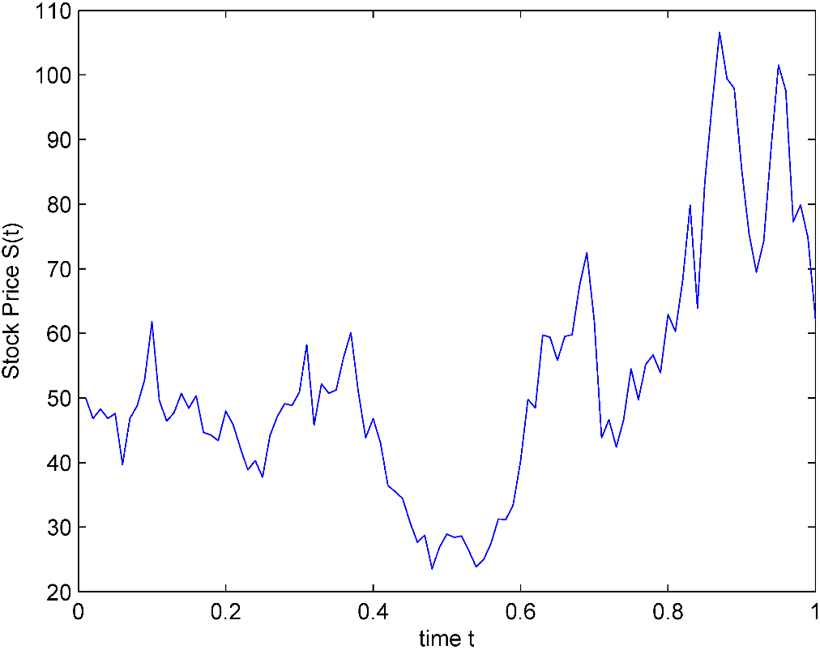
Random Process
Read book.

Slide 6

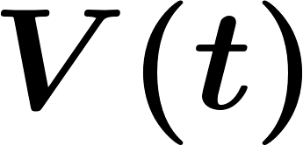
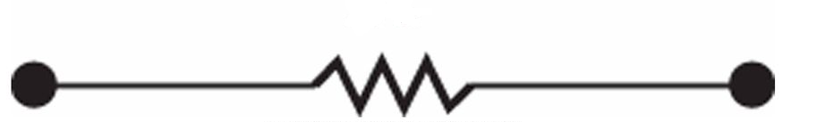
Random Process
Random process (stochastic process)
A family of random variable (usually infinite)
Example. Many random phenomena that occur in nature are function of time.

Slide 7
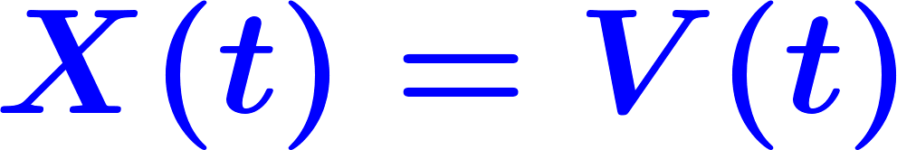

Random Process
The thermal noise voltage generated in a resistor

Slide 8

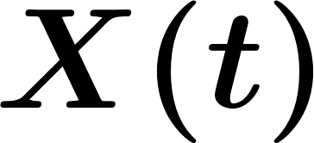
Random Process
For any fixed , the voltage is a random variable . This an example of random process. Thus, a random process (r.p.) is just a random function.
Example. is a temperature in Amherst at time

Slide 9
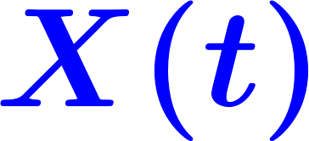


Random Process

Slide 10
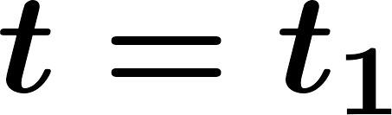
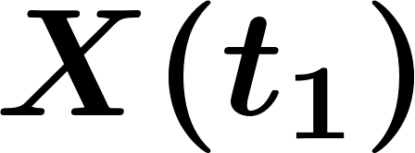
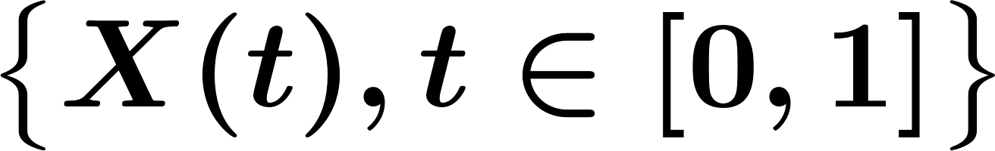
Random Process
At any time , is a random variable
Each of the possible outcomes (functions) is called a sample function.
These are examples of continuous-time random processes:

Slide 11
Random Process
Discrete-time random process:

Slide 12
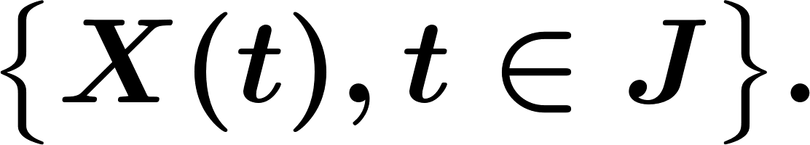
Random Process
A random process is a collection of random variables usually indexed by time.

Slide 13
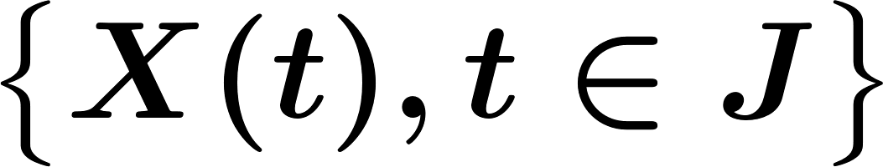

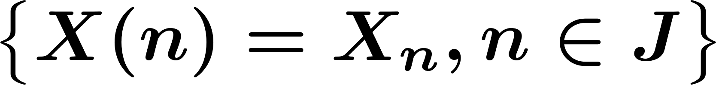


Random Process
A continuous-time random process is a random process , where is an interval on the real line such as etc.
A discrete-time random process (or a random sequence) is a random process
, where is a countable set such as or .

Slide 14

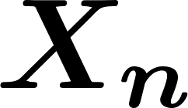

Random Process
A random process is a random function of time.
Example. You have 1000 dollars to put in an account with interest rate , compounded annually. That is, if is the value of the account at year , then
The value of is a random variable that is determined when you put the money in the bank, but it does not change after that. In particular, assume that

Slide 15
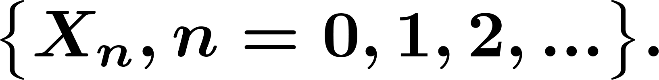

Orchestrated Conversation: Random Process
Find all possible sample functions for the random process
Find the expected value of your account at year three. That is, find

Slide 16
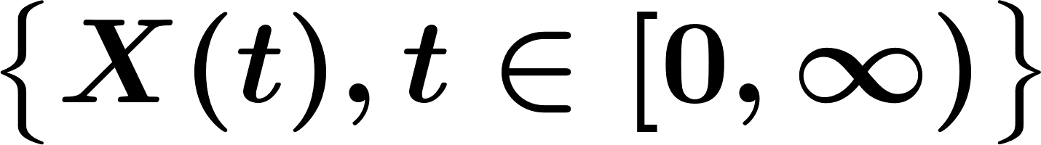


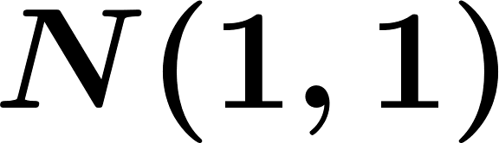
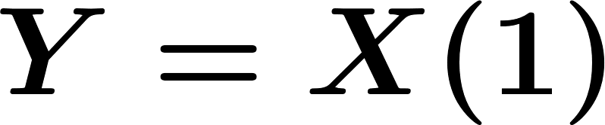
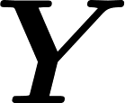
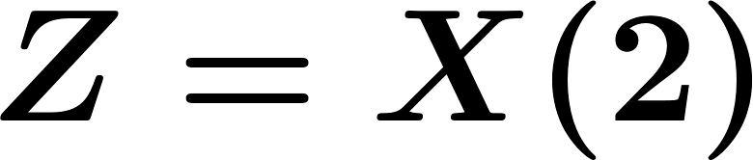

Random Process
Example. Let be defined as
where and are independent normal random variables.
Find all possible sample functions for this random process.
Define the random variable . Find the PDF of .
Let also . Find .

Slide 17
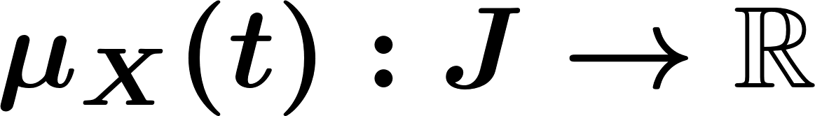
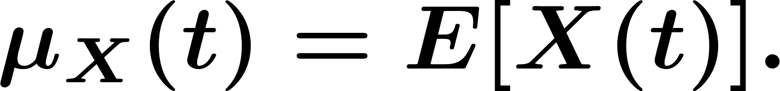
Mean and Correlation Functions
Mean Function of a Random Process
For a random process the mean function , is defined as

Slide 18
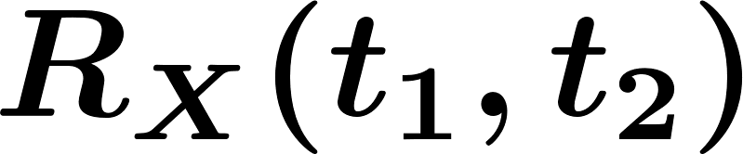
Mean and Correlation Functions
For a random process , the autocorrelation function or, simply, the correlation function, , is defined by

Slide 19
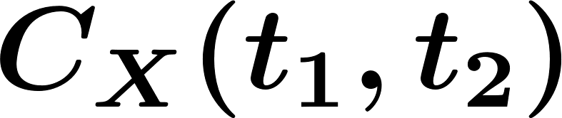
Mean and Correlation Functions
For a random process , the autocovariance function or, simply, the covariance function, , is defined by

Slide 20
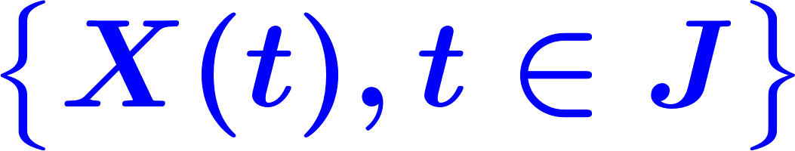
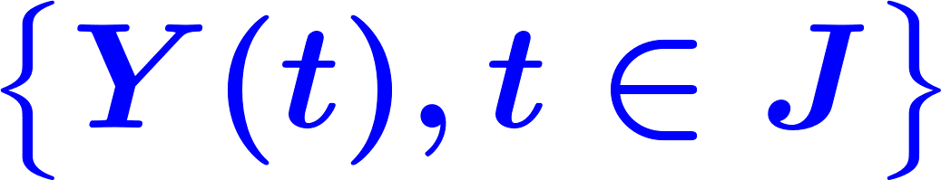
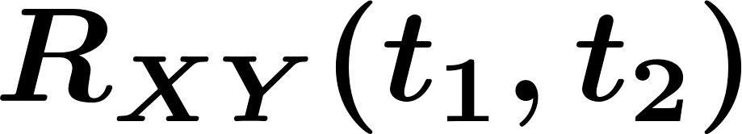
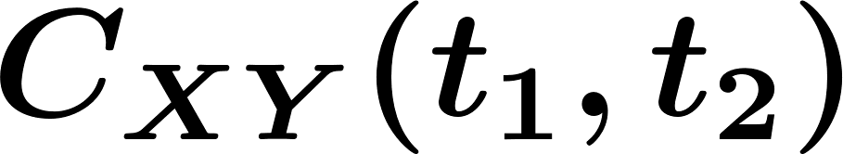
Multiple Random Processes
For two random processes and :
the cross-correlation function , is defined by
the cross-covariance function , is defined by

Slide 21
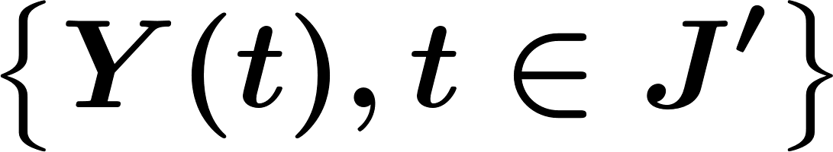
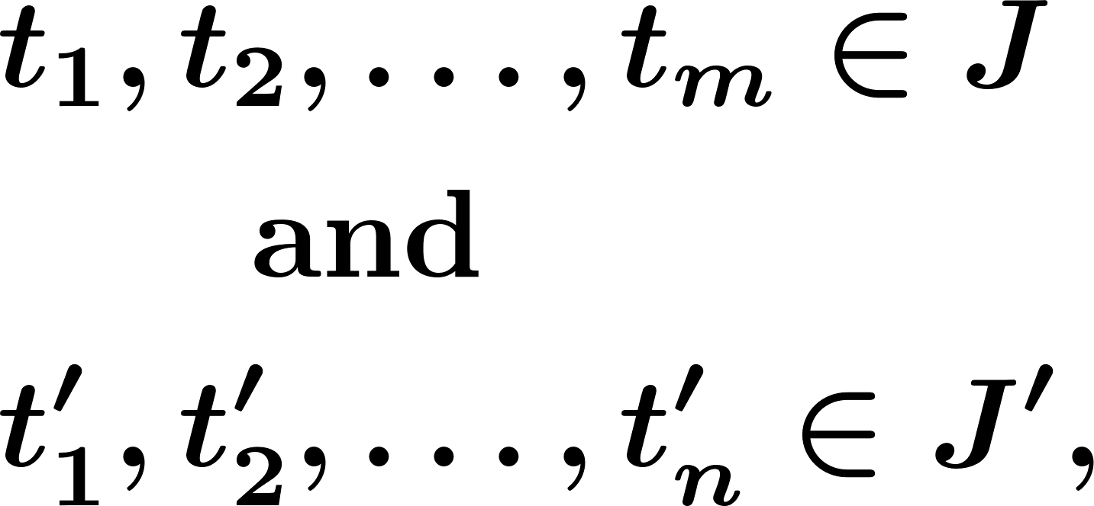
Multiple Random Processes
Two random processes and are said to be independent if, for all
the set of random variables
are independent of the set of random variables

Slide 22

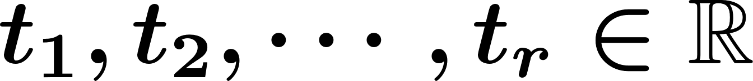

Stationary Processes
A continuous-time random process is strict-sense stationary or simply stationary if, for all and all , the joint CDF of
is the same as the joint CDF of

Slide 23
Stationary Processes
That is, for all real numbers , we have

Slide 24
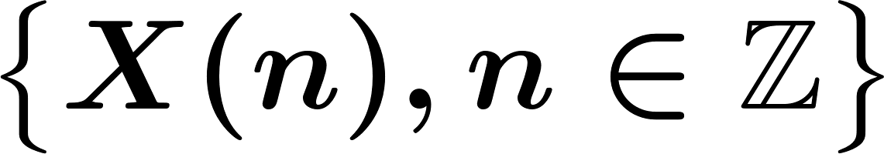

Stationary Processes
A discrete-time random process is strict-sense stationary or simply stationary, if for all and all , the joint CDF of
is the same as the joint CDF of

Slide 25
Stationary Processes
That is, for all real numbers , we have

Slide 26
Stationary Processes
Weak-Sense Stationary Processes:
A continuous-time random process is weak-sense stationary or wide-stationary (WSS) if

Slide 27
Stationary Processes
Weak-Sense Stationary Processes:
A discrete-time random process is weak-sense stationary or wide-stationary (WSS) if

Slide 28
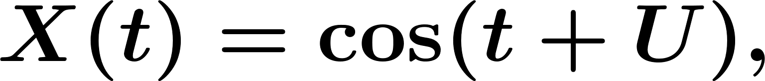
Stationary Processes
Example. Consider the random process defined as
where . Show that is a WSS process.

Slide 29
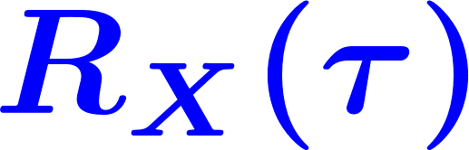
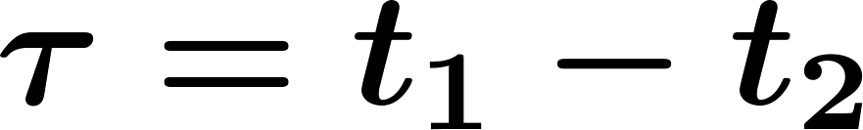
Stationary Processes
Properties of :
If WSS,

Slide 30
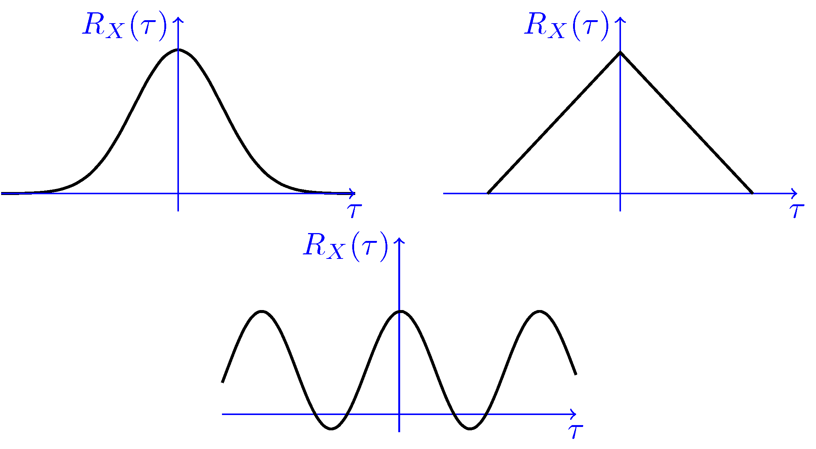
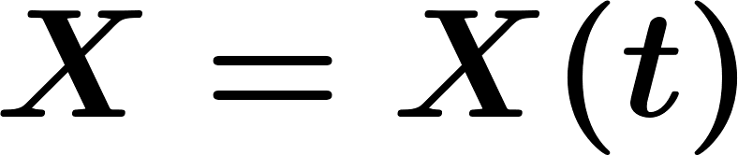
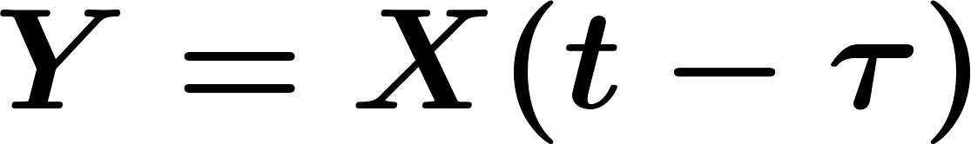
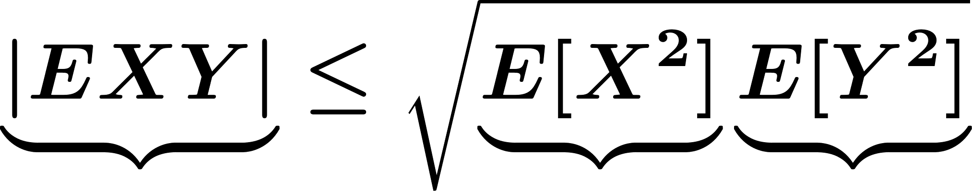
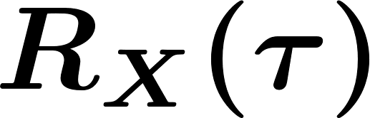
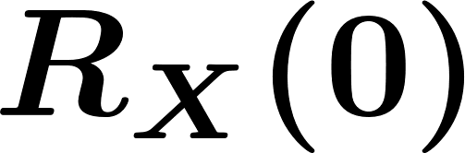
Stationary Processes
Proof:

Slide 31

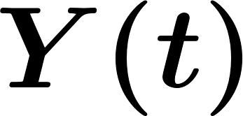
Stationary Processes
Jointly Wide-Sense Stationary Processes:
Two random processes and are said to be jointly wide-sense stationary if
and are each wide-sense stationary.
For WSS

Slide 32
Stationary Processes
Cross Covariance:

Slide 33
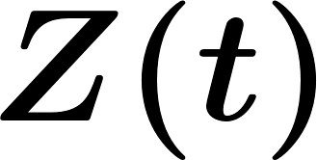
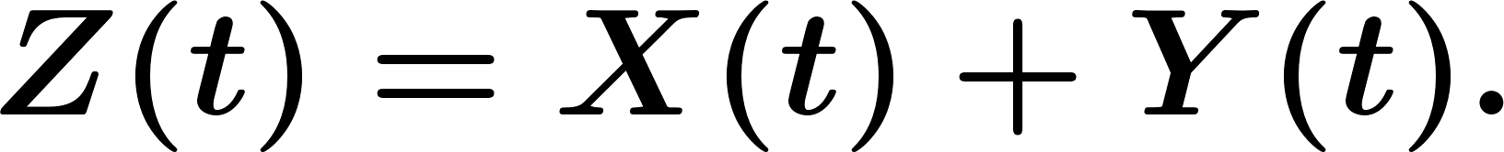
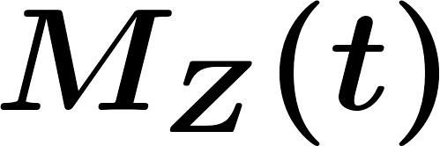
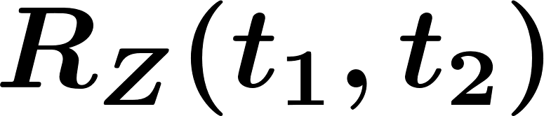
Orchestrated Conversation: Stationary Processes
Example. Let and be two jointly WSS random processes. Consider the random process defined as
Find and .
Is a WSS random processes?

Slide 34
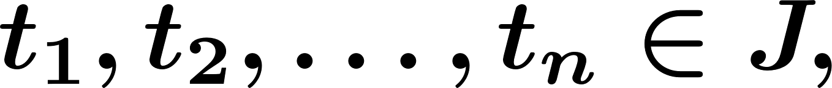
Gaussian Random Processes
A random process is said to be a Gaussian (normal) random process if, for all
the random variables are jointly normal.

Slide 35
Summary of Random Process

Slide 36
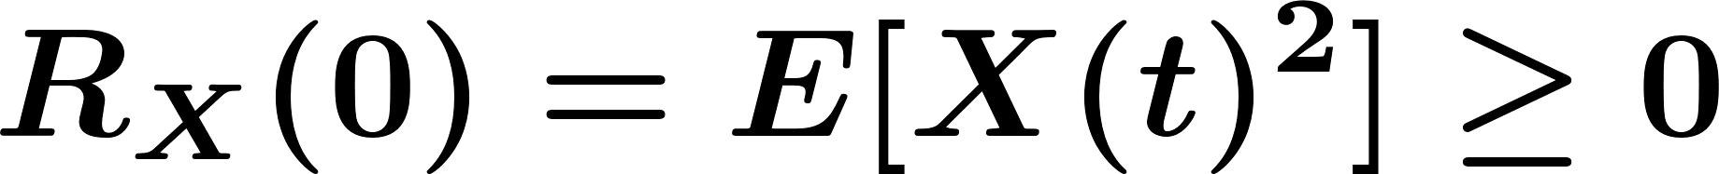
Summary of Random Process

Slide 37

Stationary Processes
Cyclostationary Processes:
Some practical random processes have a periodic structure. That is, the statistical properties are repeated every units of time (e.g., every seconds).
Example. Temperature in a city

Slide 38
Stationary Processes
A continuous-time random process is cyclostationary if there exists a positive real number such that, for all , the joint CDF
is the same as the joint CDF of

Slide 39
Stationary Processes
A continuous-time random process is weak-sense cyclostationary or wide-sense cyclostationary if there exists a positive real number such that

Slide 40
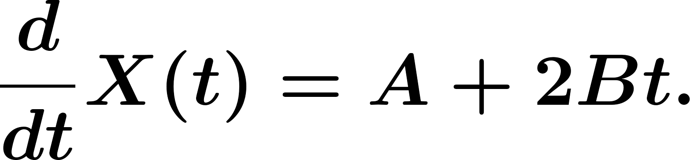
Stationary Processes
Derivatives and Integrals of Random Processes:
Example.
Then
We need to first talk about limits and continuity.

Slide 41
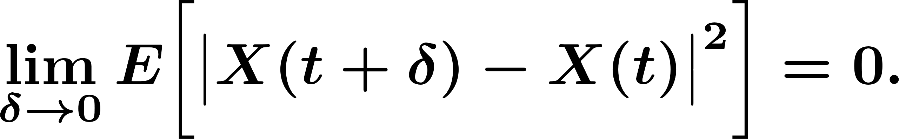
Stationary Processes
Mean‐square continuity:

Slide 42

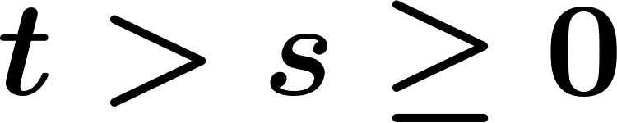

Stationary Processes
Example. The Poisson process is discussed in detail in Chapter 11. If is a Poisson process with intensity , then for all , we have
Show that is mean-square continuous at any time .

Slide 43


Stationary Processes
More specifically, we can write

Slide 44
Gaussian Random Processes
A random process is said to be a Gaussian (normal) random process if, for all
the random variables are jointly normal.

Slide 45

Processing of Random Signals
If is a random process, then is a random process.
System
(LTI)
Input signal
output signal
Notes:
Now: Slides with Annotation

Slide 46

Power Spectral Density
Power Spectral Density (PSD)
Notes:
Now: Slides with Annotation

Slide 47
Power Spectral Density
Properties:
Notes:
Now: Slides with Annotation

Slide 48



Power Spectral Density
Expected power:
Notes:
Now: Slides with Annotation

Slide 49

Power Spectral Density
The expected power in can be obtained as
Notes:
Now: Slides with Annotation

Slide 50


Power Spectral Density
Example. Consider a WSS random process with
where is a positive real number. Find the PSD of .
Notes:
Now: Slides with Annotation

Slide 51
Power Spectral Density
Cross Spectral Density:
Notes:
Now: Slides with Annotation

Slide 52

Linear Time-Invariant (LTI) Systems
Linear Time-Invariant (LTI) Systems:
Random
Random
Notes:
Now: Slides with Annotation

Slide 53


Linear Time-Invariant (LTI) Systems
Linear Time-Invariant (LTI) Systems:
Notes:
Now: Slides with Annotation

Slide 54

Linear Time-Invariant (LTI) Systems
LTI Systems with Random Inputs:
Let be a WSS random process.
Notes:
Now: Slides with Annotation

Slide 55




Linear Time-Invariant (LTI) Systems
The mean function of
Notes:
Now: Slides with Annotation

Slide 56


Linear Time-Invariant (LTI) Systems
The cross-correlation function:
Notes:
Now: Slides with Annotation

Slide 57



Linear Time-Invariant (LTI) Systems
The cross-correlation function:
Notes:
Now: Slides with Annotation

Slide 58

Linear Time-Invariant (LTI) Systems
Similarly
Notes:
Now: Slides with Annotation

Slide 59


Linear Time-Invariant (LTI) Systems
Theorem. Let be a WSS random process and be given by
Where is the impulse response of the system. Then and are jointly WSS. Moreover,
Notes:
Now: Slides with Annotation

Slide 60

Linear Time-Invariant (LTI) Systems
Notes:
Now: Slides with Annotation

Slide 61




Linear Time-Invariant (LTI) Systems
Frequency Domain Analysis: let be the Fourier transform of .
Notes:
Now: Slides with Annotation

Slide 62
Linear Time-Invariant (LTI) Systems
by taking the Fourier transform from both sides
Notes:
Now: Slides with Annotation

Slide 63
Linear Time-Invariant (LTI) Systems
by taking the Fourier transform from both sides
Notes:
Now: Slides with Annotation

Slide 64





Linear Time-Invariant (LTI) Systems
Example. Let be a zero-mean WSS process with . is input to an LTI system with
Let be the output.
Find
Find
Find
Notes:
Now: Slides with Annotation

Slide 65

Power in a Frequency Band
Total Power:
Notes:
Now: Slides with Annotation

Slide 66




Power in a Frequency Band
Power in frequency range to :
Notes:
Now: Slides with Annotation

Slide 67


Power in a Frequency Band
Thus, the power in is
Notes:
Now: Slides with Annotation

Slide 68



Power in a Frequency Band
Gaussian Processes through LTI Systems:
Gaussian WSS
WSS
Linear combination of
Notes:
Now: Slides with Annotation

Slide 69


Power in a Frequency Band
Example.
noise
Notes:
Now: Slides with Annotation

Slide 70



White Processes
A process is called a white process if
Notes:
Now: Slides with Annotation

Slide 71

White Processes
It is Not a meaningful physical process.
Notes:
Now: Slides with Annotation

Slide 72


White Processes
In reality:
The constant is usually denoted as for white noise.
Notes:
Now: Slides with Annotation

Slide 73


White Processes
Notes:
Now: Slides with Annotation

Slide 74





White Processes
Where is the dirac delta function
Thus for any .
The thermal noise ( ) that affects electronic systems has a very wide range BW and can be modeled by white noise.
Notes:
Now: Slides with Annotation

Slide 75




White Processes
Properties of thermal noise,
is WSS.
is a Gaussian Process.
is white
Notes:
Now: Slides with Annotation

Slide 76


Filtered Noise Process
Usually the white noise generated in one stage of the system is filtered by the next stage.
Band Pass Process:
Notes:
Now: Slides with Annotation

Slide 77




Filtered Noise Process
Example. if
Notes:
Now: Slides with Annotation

Slide 78

Filtered Noise Process
then
Filtered noise (a Band pass signal)
Notes:
Now: Slides with Annotation

Slide 79
Post-work for Lesson
Complete homework assignment for Lessons 18-20:
HW#10
Go to the online classroom for details.
Notes:
Now: Slides with Annotation

Slide 80
To Prepare for the Next Lesson
Read Chapter 11 in your online textbook:
https://www.probabilitycourse.com/chapter11/11_0_0_intro.php
Complete the Pre-work for Lessons 21-24.
Visit the online classroom for details.
Notes:
Now: Slides with Annotation

